Slide 1
Review of the Current Economic Situation
June 1, 2016
Paul A. Strassmann

Slide 2
The Rising Importance of China in the Global Economy
China Economy

Slide 3
USA Share of Global GNP Declines as China is Rising

Slide 4
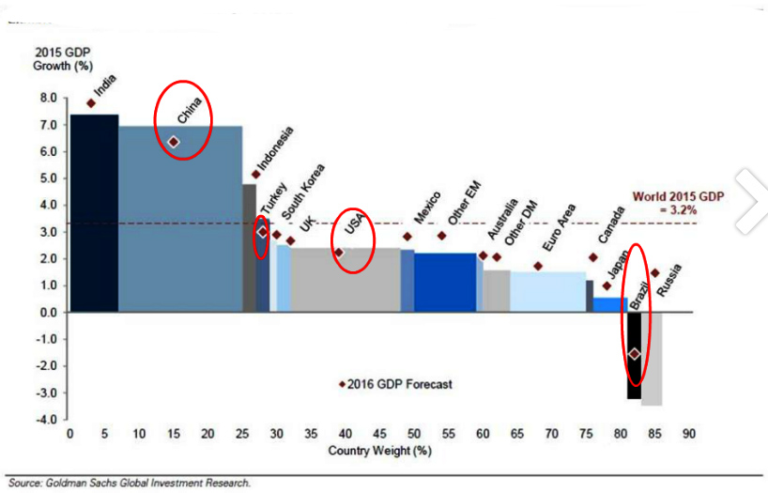
Growth of China Overwhelms All Others

Slide 5
China’s GNP Growth Overwhelms the Growth of Emerging Countries

Slide 6
Threat from China Maybe Less than Expected

Slide 7
Falling Commodity Prices Signal Slowing Down of China Growth

Slide 8
The Economics of Robert Shiller
Robert Shiller - Yale

Slide 9
Approaches to Investment Methods
Robert Shiller
Ben Graham
Undervalued Predictable
Buffett-Munger
Historical Low Price/Sales
Historical Low Price/Book
Peter Lynch Screen
High Short Interest
Predictable Companies
Dividend Stocks

Slide 10
Ben Graham Approach
Shiller is disciple of Ben Graham
Acquire issues below two thirds of book value.
Only net-current-assets are of value.
Results:
Portfolios returned 29.4%, over 13-years compared to 11.5% for S&P 500 Index.

Slide 11
CAPE – The Key Shiller Indicator

Slide 12
The Calculation of CAPE

Slide 13
The History of Shiller’s CAPE

Slide 14
Current Valuation of the Stock Market According to Shiller

Slide 15
Any Other Indicators Suggest Recession?

Slide 16
Drop in S&P Also Suggests a Coming Recession

Slide 17
An Independent Review by NBER Also Indicates Recession Trend

Slide 18
Stock Market Valuations Push the Enterprise Value to Limits

Slide 19
Net Profit Margins Rise, But Not from Operatios

Slide 20
Summary Observations
China GNP growth will displace the #1 position of the USA, but will be slowing down.
Based on Shiller there are strong indications that a recession in incipient, although its time is indeterminate.

